Slide 1

Vrinda Stores Annual Report
A dashboard of the vrinda stores analysis report which solves different problems

Slide 2
Compare sales and orders using single chart
Which month got the highest sales and orders
Who purchased more men are women
What are different types of orders
Top 10 sales contributing the sales
Relation between gender and age
Which channel is contributing highest sales
Our Problem

Slide 3

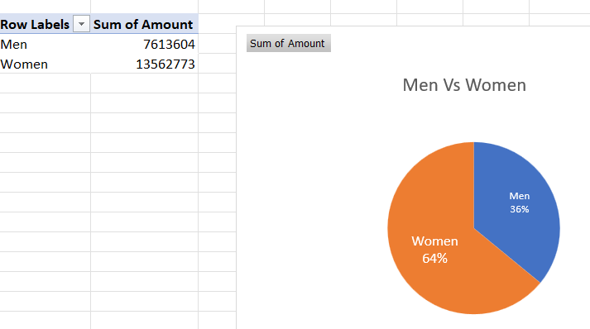


Insights
Sales :Men Vs Women
As per our sales report most of the women contributing the highest sales by 64%
And men are contributing total 36% sales
Pivot table:

Slide 4
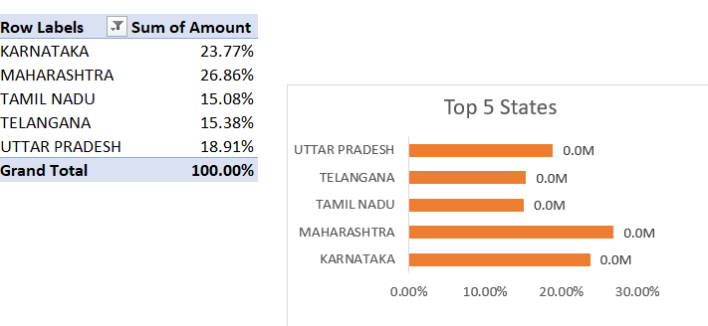
Insights
Sales : Top 5 states
As per our sales report top 5 states that contributing sales are
Karnataka,
Maharashtra,
Tamil Nadu,
Telangana,
Uttar Pradesh
Pivot table:

Slide 5
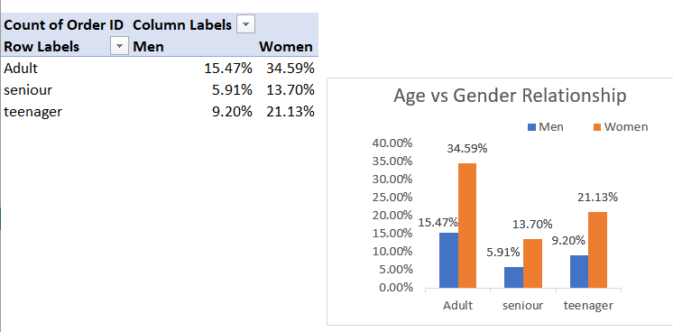
Insights
Relationship of Age and Gender
As per our report there are three categories are there and those are
Adult
Senior
Teenager
Pivot table:

Slide 6
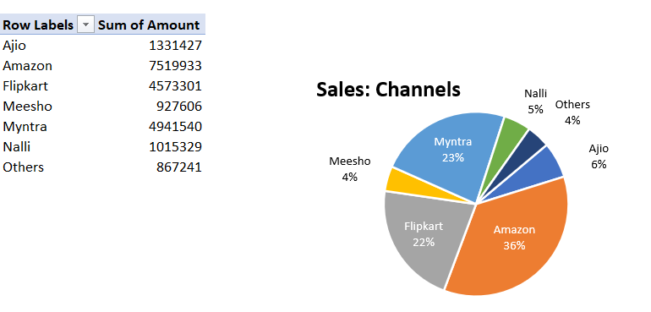
Insights
Top Channels Contributing Sales And Orders
As per our report there are three categories are there and those are
Amazon
Flipkart
Myntra
Pivot table:

Slide 7
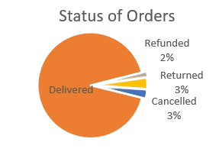
Status Analysis
Based on this sales pie chart we considered that most of the percentage of orders has been delivered
Refunded
Returned
2%
3%
92%
Canceled
Delivered
3%
92%

Slide 8
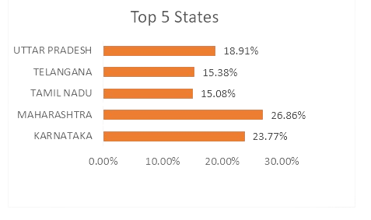
Sales Contributed By States
Top 5 states
S. No | States | SALES
1 | Maharashtra | 26.8%
2 | Karnataka | 23.77%
3 | Uttar Pradesh | 18.91%
4 | Telangana | 15.38%
5 | Tamil Nadu | 15.08%

Slide 9

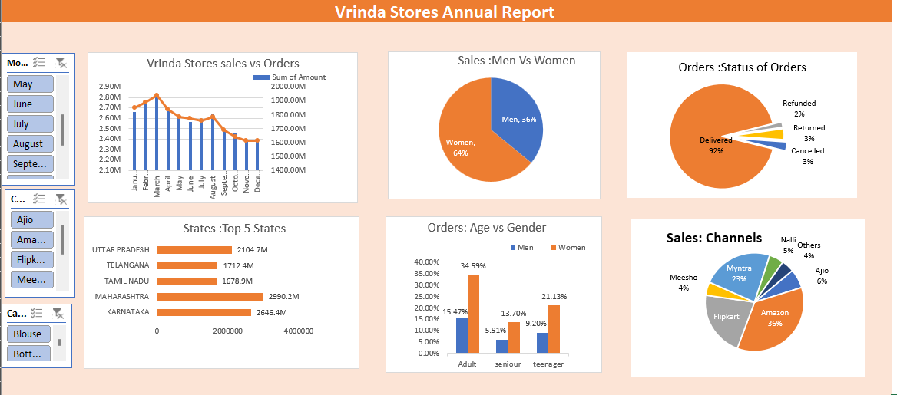
Annual Report
Vrinda Stores Annual Report Based On Our Problems
Vrinda Stores Dashboard

Slide 10

Conclusion
Based On Our Reports Dashboard We Concluded That The Top 5 States And Men Vs Women's Who Are Sales And Orders For The Types Of Channel

Slide 11
Thank You!
We respect your valuable time

